Slide 1
Consumer Decision Making Shopping

Slide 2
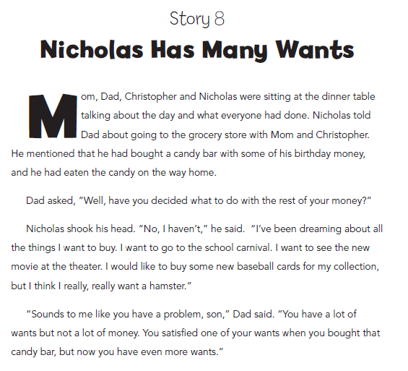

Slide 3
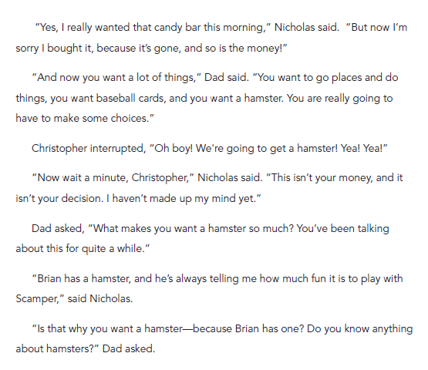

Slide 4
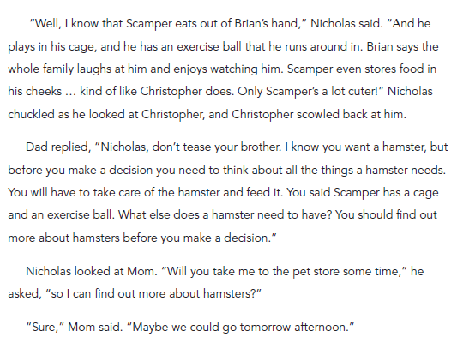

Slide 5
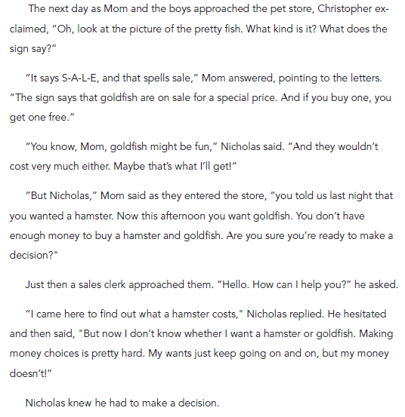

Slide 6
Procedure
What are some examples of goods in the story?
Introduce the term consumer
Consumer is someone who buys and uses goods and services to satisfy wants

Slide 7
Identify the consumer in the following and the good or service
A teacher got some paper for her classroom
from Mrs. Thompson at the school supply
store.
Marcus bought flowers to give to his mother for her birthday
Nicholas watched the firemen working to put out the fire at Mrs. Brown’s house.
Notes:
Marcus, not mother is consumer

Slide 8
What spending choice must Nicholas make?
Use a decision making grid or apron to make your choice.

Slide 9
Spending and Credit Theme 3 – Lesson 11 (3-5)
This One or That One?
A lesson on consumer decision making

Slide 10
Why comparison shop?
Because income is always limited relative to wants, people must make choices.

Slide 11
Vocabulary
Criteria- Important ideas to consider when making a decision.
Price: The amount consumers pay for a good or service.
Unit Price: The retail price per unit of a given product. (e.g., the price per ounce, gallon, etc.)

Slide 12
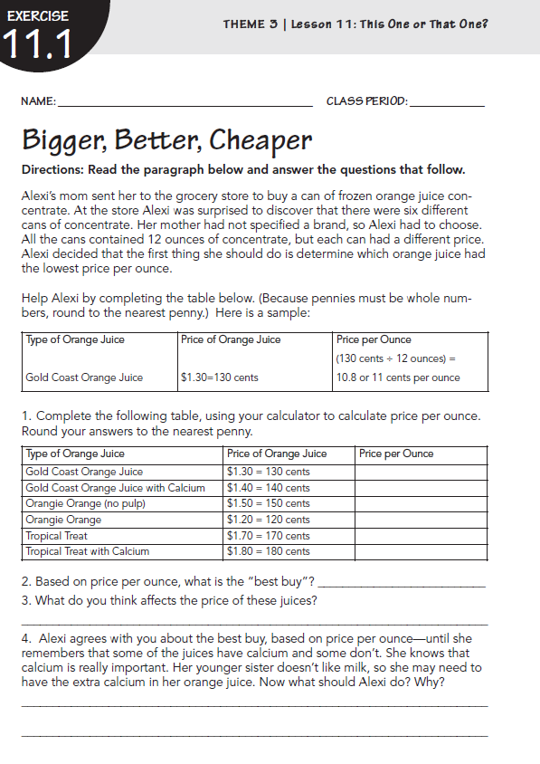

Slide 13
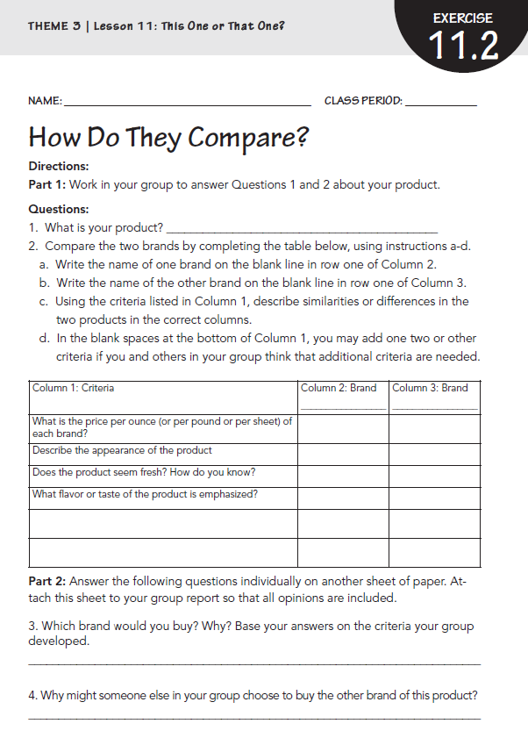

Slide 14
The Economic Way of Thinking – Lesson 3 (6-8), Activity 3.2
Choosing the Better Incentive
A lesson on consumer decision making

Slide 15
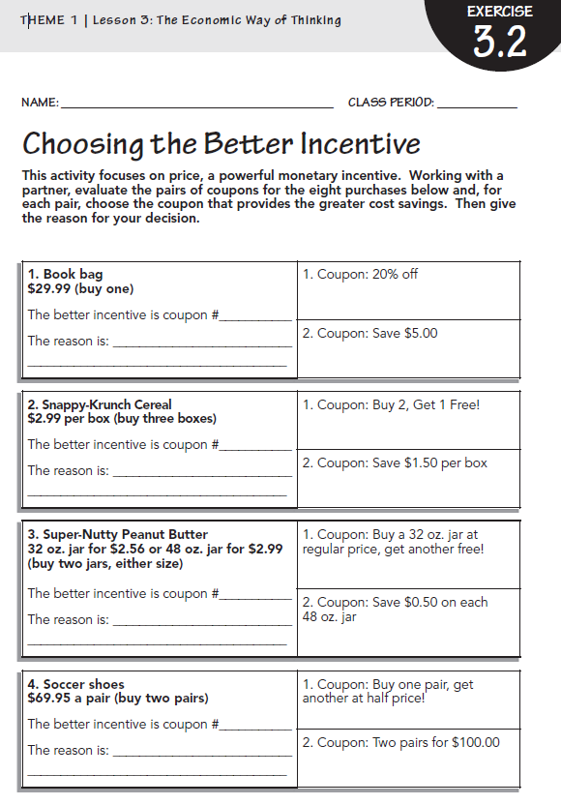

Slide 16
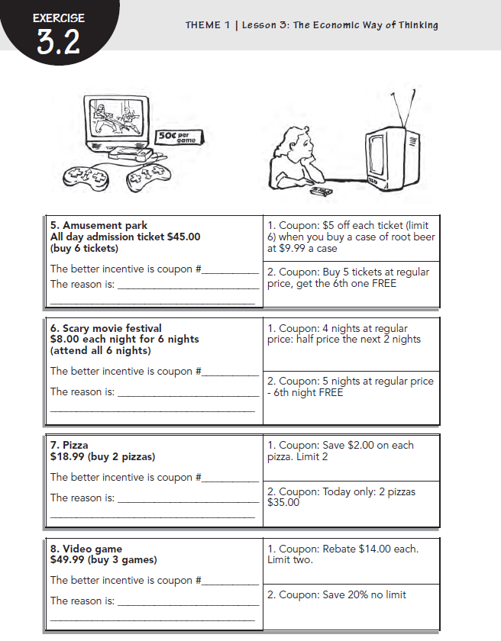

Slide 17
Parent Guide 3-5

Slide 18
Parent Guide 3-5

