Slide 1
Saving is Spending Later

Slide 2
K-2 lesson: Why We Save

Slide 3
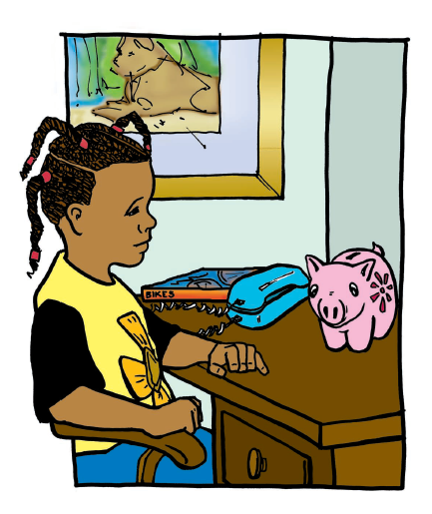

Slide 4
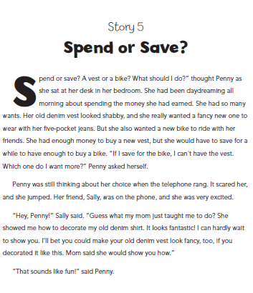

Slide 5
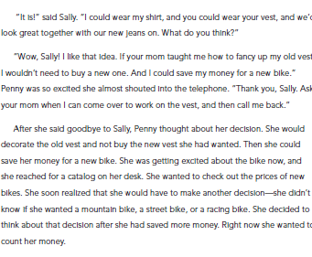

Slide 6
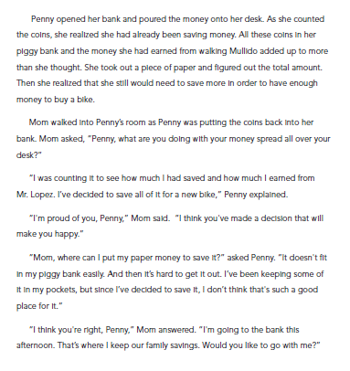

Slide 7
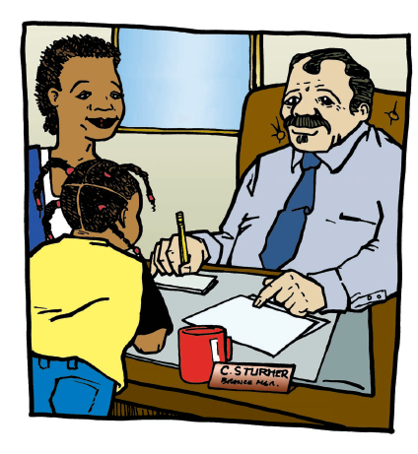

Slide 8
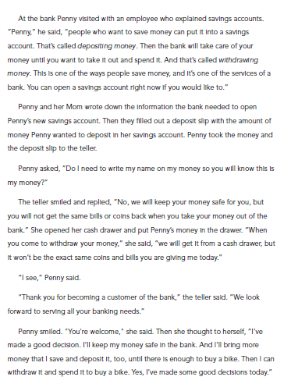

Slide 9
Debriefing Questions
What was the decision that Penny had to make?
Why did Penny want a new vest?
Why did Penny have to make a choice between the vest and the new bicycle?

Slide 10
Debriefing Questions
What did Penny give up in order to save money for buying a bike later?
What do you call the item that you have to give up when you make a choice?

Slide 11
Debriefing Questions
Where do you think Penny should keep her money? Why?
Do you recall what Penny learned about savings accounts, deposits, and withdrawals when she visited the bank with her mother?

Slide 12
Activities
Activity One
Activity Two
Activity Three

Slide 13
3-5 Lesson: Saving Starts with Wanting More

Slide 14
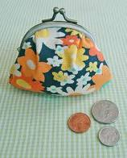
What do these things have in common?

Slide 15
Goals

Slide 16
All Goals Need to be:
Meaningful
Specific What, Why, How
Attainable
Time Bound

Slide 17
Savings Goals
Short term goals
Long term goals

Slide 18
Exercise 5.1

Slide 19
Exercise 5.2—Set a Goal

Slide 20
Goals are Incentives

Slide 21
Interest is an Incentive

Slide 22
Watching Money Grow

Slide 23
How Much do You Need to Save to Reach Your Goal?

Slide 24
Where Will You Keep Your Savings?

Slide 25
Where Will You Keep Your Savings?

Slide 26
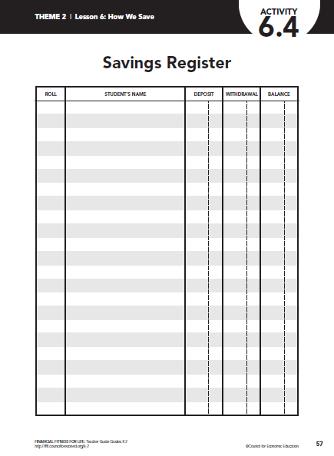
Keeping Track of Your Money

Slide 27
Keeping Track of Your Money

