Slide 1
Real World Math
Presenters
Pam Whalley, Center for Economic and Financial Education
Bobby DeGrouche, Financial Fellow

Slide 2
Why Teach Math/Personal Finance in Your Classes?
Only one in six U.S. students receives financial education
90% of parents think that k-12 schools should teach personal finance
( https://investor.equifax.com/news-and-events/news/2018/04-30-2018-140352714)
Financial education
Decreases the amount students borrow as they head to college. (Average debt per borrower: $32,731 , Forbes)
Increases the use of lower cost student loans
Decreases credit card balances
Higher credit scores
Lower default rates
Gives people more control over their lives

Slide 3
Making Consumer Choices: Which is the Better Buy?
Basic set-up: you are given a purchase decision with two applicable coupons. You must decide which coupon generates the largest discount for your planned purchase
Kahooting—Five questions
The first two questions you only have 30 seconds to answer
The last three questions, you have 1.5 minutes to answer
Accuracy and Speed both count
Kahoot.it
How did you approach the problem?
Financial Fitness for Life, 6-8

Slide 4
Washington State Financial Education Standards
Financial Decision Making
Make criterion-based financial decisions by systematically considering alternatives and consequences.
Spending and Saving
Develop a plan for spending and saving
Apply consumer skills to spending and saving decisions.

Slide 5
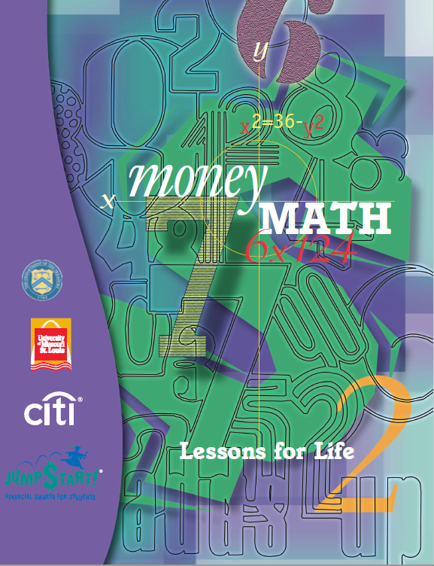
https://www.treasurydirect.gov/indiv/tools/tools_moneymath.htm

Slide 7
Standards and Concepts
Financial Education Standards
Employment and Income
Explore job and career options.
Mathematics:
understand numbers
work flexibly with fractions, decimals, and percents
ways of representing to solve problems
numbers, relationships
develop meaning for percents greater than 100 and less than
numbers to solve problems

Slide 8
Part One
Distribute Problem cards
Each card describes a person with a particular occupation and a problem facing that person
Read the cards, decide what types of math skills/calculations each person must use to solve his or her problem, solve the problem where possible, and explain their reasoning in words.
Activity 3.1 Math is Everywhere

Slide 9
Card One--Example

Slide 10
Card Two--Example

Slide 11
Card Three--Example

Slide 12
Card Four--Example

Slide 13
Debrief
What did all people described on the cards have in common?
What types of mathematics skills were required?
Think of other occupations that also require the use of mathematics skills.
Can you think of tasks that you or others at home do that require the use of mathematics?

Slide 14
