Slide 1
Financial Education Novice Training
Pamela Walley
Dottie Record
Brenda Leighty
June 28, 2019
Notes:
What is money? Interview with children…funny☺
https://www.youtube.com/embed/ZP57Kn9eAAQ

Slide 2
The Millionaire Game
Notes:
PLAY The Millionaire Game!
Note to self:
FFFL recognizes that while financial technology may have changed how people carry out financial transactions, it has not changed what students need to know to help them make informed decisions.

Slide 3
The Importance of Financial Education
Notes:
Note to self:
FFFL recognizes that while financial technology may have changed how people carry out financial transactions, it has not changed what students need to know to help them make informed decisions.

Slide 4
Decision Making
Notes:
Note to self:
FFFL recognizes that while financial technology may have changed how people carry out financial transactions, it has not changed what students need to know to help them make informed decisions.

Slide 5
Financial Fitness for Life Grades 6-8 Lesson 2: Making Decisions
Alternatives
Cost/benefit analysis
Criteria
Decision-making
Opportunity cost
Trade-offs
Notes:
This lesson builds on lesson 1, introducing students to The Economic Way of Thinking: People must make choices, and EVERY choice involves a cost.
Students practice using the PACED decision-making process.
Credit Decisions Video and Kahoot!
https://www.econedlink.org/resources/credit-decisions-video-and-quiz/

Slide 6
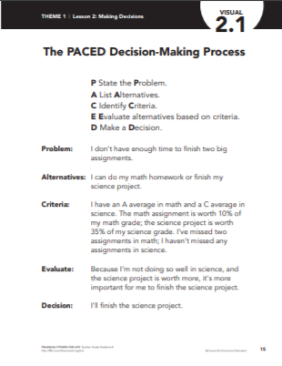
Five Step Decision Making Process
1. Define the Problem
2. List Your Alternatives
3. State Your Criteria
4. Evaluate Your Alternatives
5. Make a Decision

Slide 7
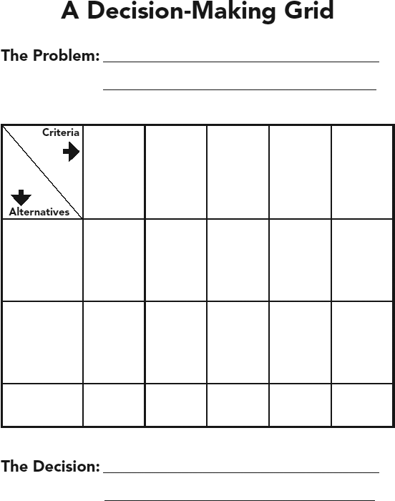

Slide 8
Lets have some fun!
Which Graham Cracker is best??
A & B ONLY

Slide 9
Financial Fitness for Life Grades 9-12 Lesson 3: Making Decisions
Opportunity Cost
Decision Making
Scarcity

Slide 10
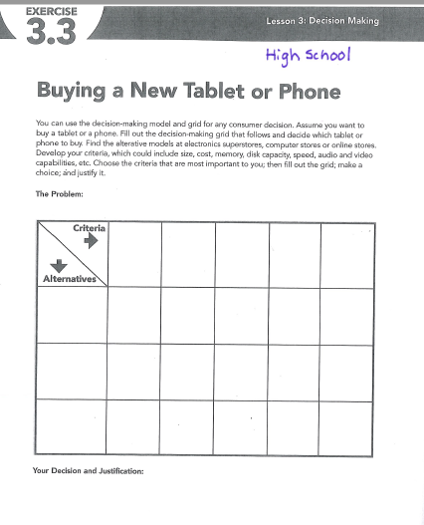

Slide 11
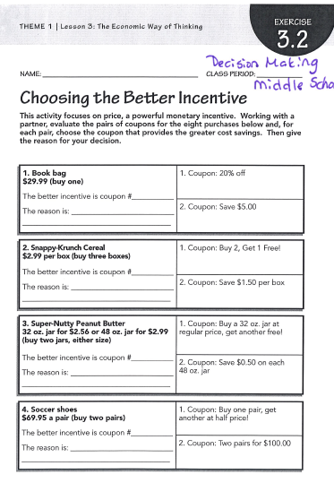
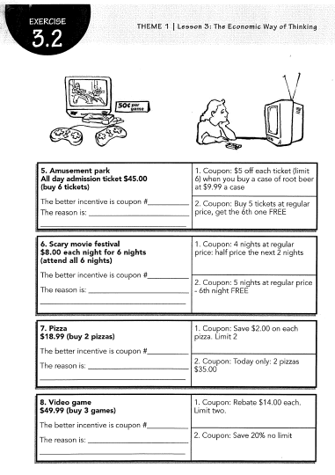

Slide 12
Earning an Income

Slide 13
Financial Fitness for Life Grades 9-12 Lesson 6: Why Some Jobs Pay More than Others
Notes:
https://www.wkyt.com/content/news/College-education-good-investment-despite-rising-costs-study-finds-511577112.html
Dottie

Slide 14
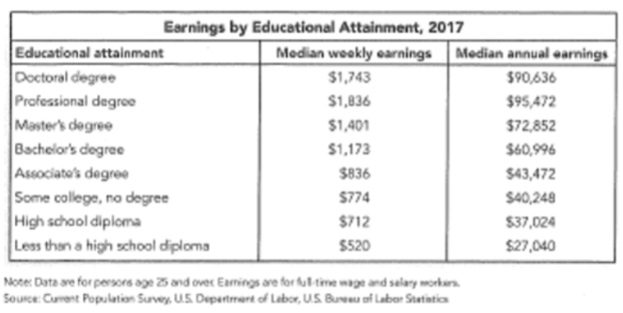

Slide 15
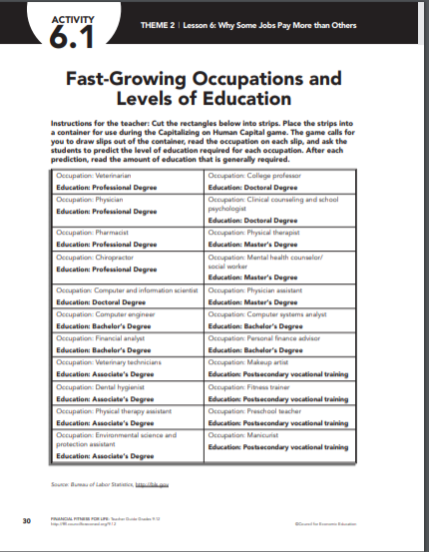
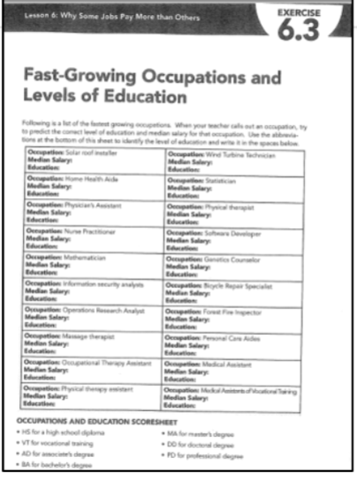

Slide 16
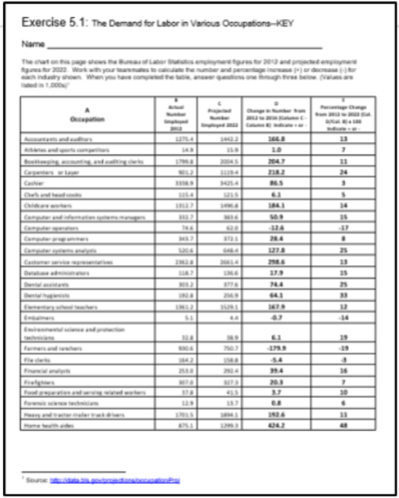
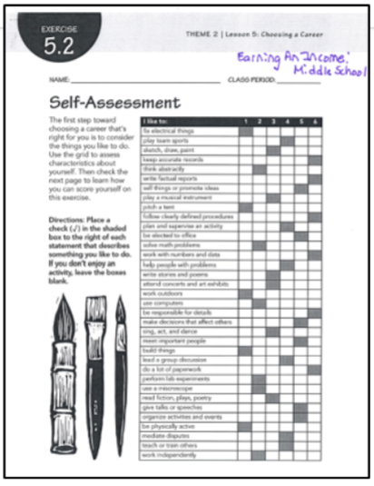

Slide 17
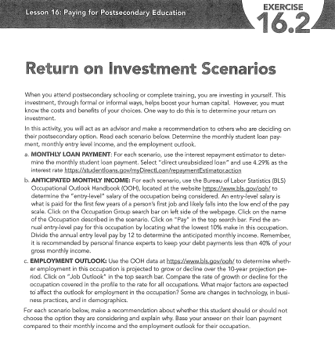

Slide 18
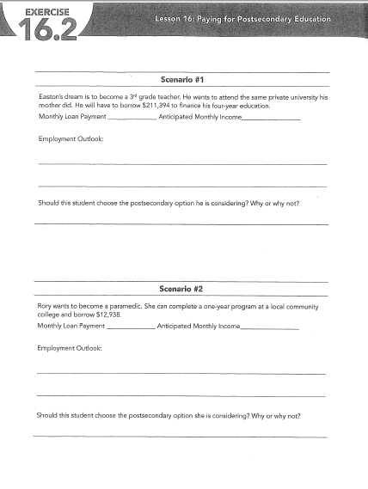

Slide 19
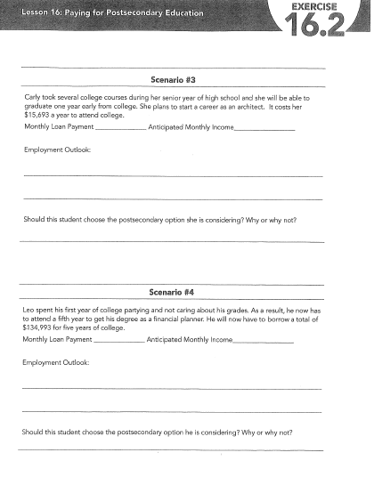

Slide 20
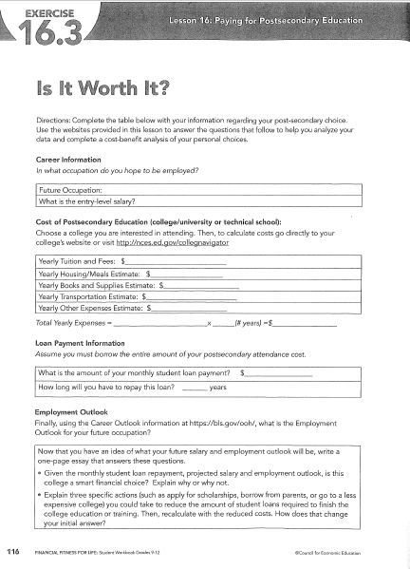

Slide 21
Working Lunch

Slide 22
Saving

Slide 23
Financial Fitness for Life Grades 6-8 Lesson 10: Why Save?
Investing
Long-term goals
Medium-term goals
Opportunity Cost
Saving
Scarcity
Short-term goals
Notes:
https://www.econedlink.org/resources/saving-and-investing-video-and-quiz/?view=teacher
Saving & Investing Video with Kahoot
Saving & Investing Video and Kahoot!
https://www.econedlink.org/resources/saving-and-investing-video-and-quiz/
Students learn about saving and investing, and they consider the importance of setting short-term, medium-term, and long term savings goals. They use math skills to solve problems.

Slide 25
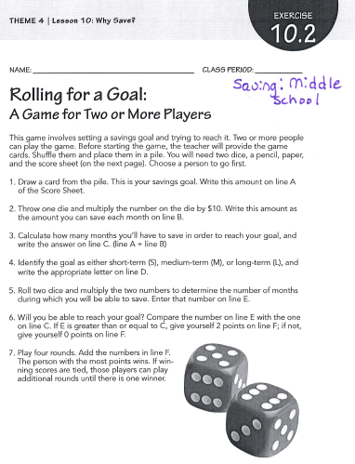
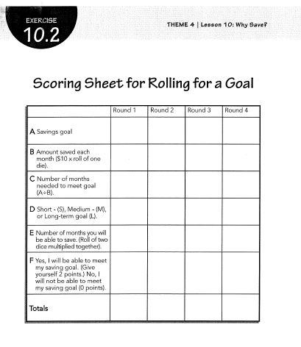
Let’s roll for a goal together!

Slide 26
Financial Fitness for Life Grades 9-12 Lesson 20: What’s the Cost of Saving and Spending?
Interest
Opportunity cost
Risk and return
Saving
Notes:
https://www.econedlink.org/resources/collection/fffl-9-12/
To find presentations, interactives and other great technology tools to enhance your teaching of this lesson.
Saving & Investing Video and Kahoot!
https://www.econedlink.org/resources/saving-and-investing-video-and-quiz/
This lesson examines the benefits and costs of spending and saving.
The students learn ow compound interest makes savings grow. Compounding provides an incentive to save and invest early.
The benefits of saving and investing when you are young can increase substantially over time when funds are allowed to compound.

Slide 27
^{Save Early and Often}
These factors affect the growth of savings:
• Time
The earlier or longer you save, the more total savings (wealth) you will have.
• Investment Size
The more you save each year from your income, the more total savings (wealth) you will have.
• Rate of Return
The higher the interest rate or rate of return, the more total savings (wealth) you will have.

Slide 28
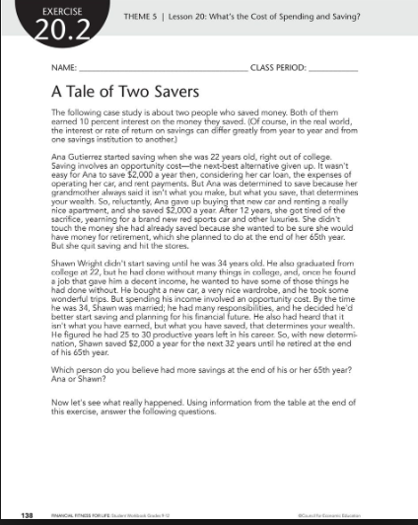
Let’s do this lesson together!
Notes:
Spend 5 minutes reading story. Be prepared to discuss which person do you believe had more savings at the end of his or her 65th year? Ana or Shawn?

Slide 29
Financial Fitness for Life Grades 9-12 Lesson 9: Financial Institutions and Services
Notes:
Visit https://www.econedlink.org/resources/collection/fffl-9-12/
To find presentations, interactives and other great technology tools to enhance your teacher of this lesson.

Slide 30
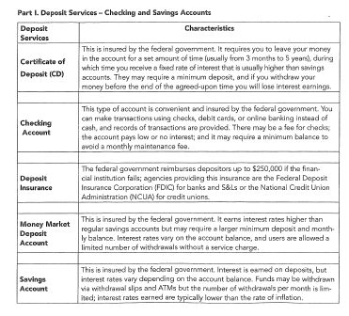
EXERCISE 9.2
Financial Services

Slide 31
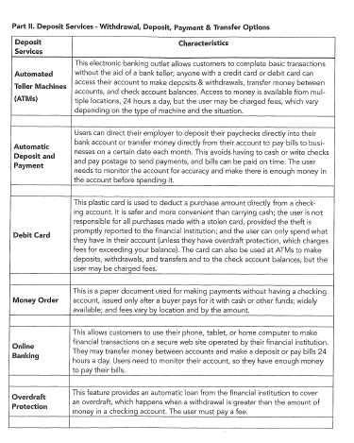
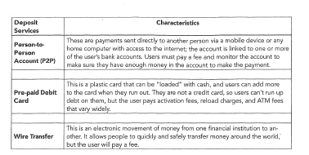

Slide 32
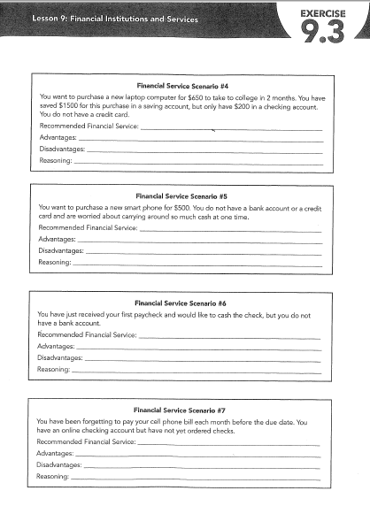
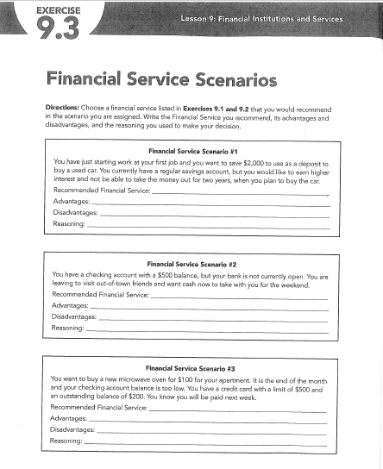
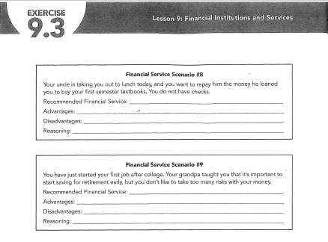

Slide 33
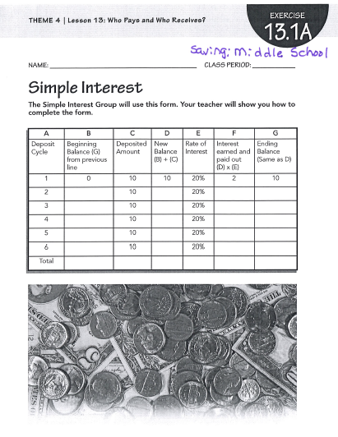
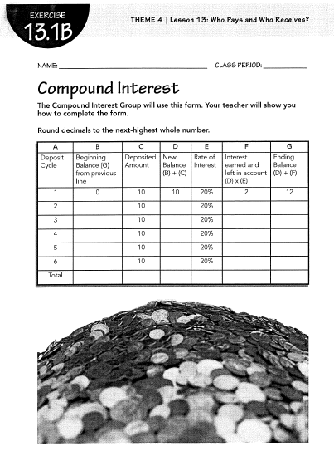
Interest

Slide 34
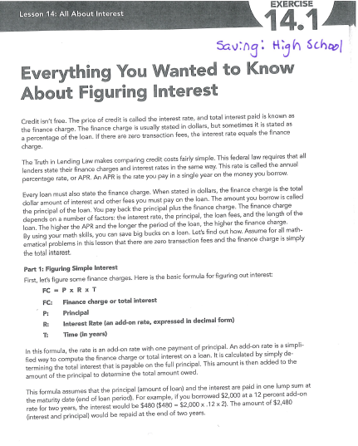

Slide 35
Credit

Slide 36
Financial Fitness for Life Grades 6-8 Lesson 15: Cash or Credit?
Annual Fee
Payment
Credit Limit
Interest Rate
Grace Period
Minimum Payment
Interest
Late Fee
Credit
Finance Charge
Notes:
Most students are aware of the variety of payment options available to consumers. Cash, checks, debit cards, and credit cards are often usued by their parents; however, the students probably do not understand the implications of each.
Lesson examines the advantages and disadvantages of various payment methods and focuses especially on using credit.
Students are challenged to calculate the cost of credit, compare credit card agreements, and analyze case studies.
Credit vs Debit Card: 2 very different cards video
https://www.youtube.com/watch?reload=9&v=XbtSftL6dbY

Slide 37
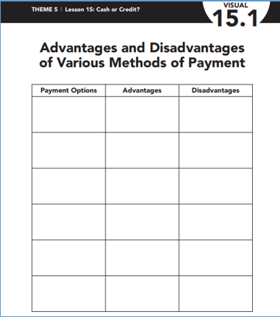

Slide 38
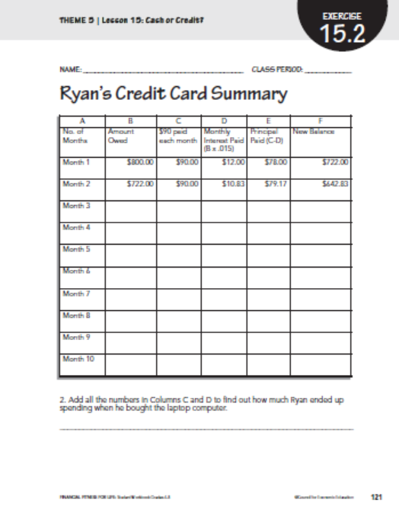
Exercise 15.2 Cash or Credit
Let’s do this together!
Notes:
Many factors come into play for consumers as they make their choices about paying in cash or buying on credit.
Show how to calculate interest
Work in pairs to complete the worksheet
(students proficient with excel have students construct a spreadsheet for this activity)

Slide 39
Financial Fitness for Life Grades 9-12 Lesson 12: Making Credit Choices

Slide 40
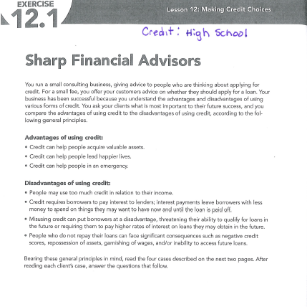
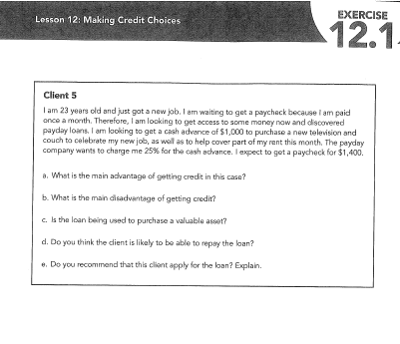

Slide 41
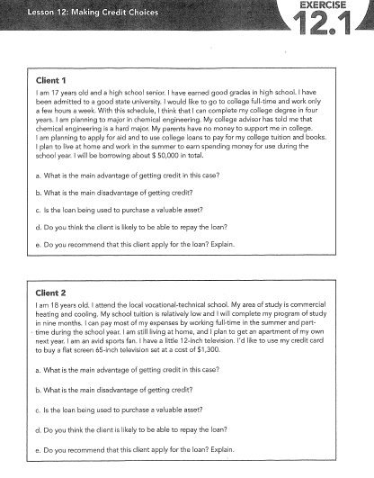
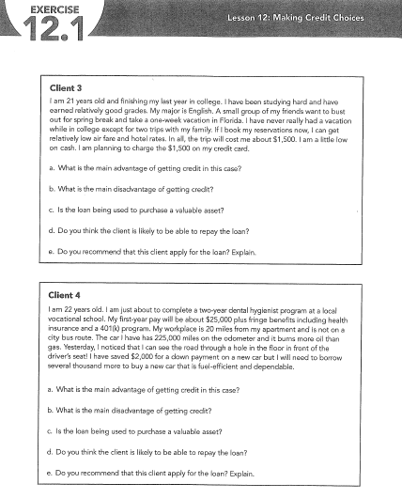

Slide 42
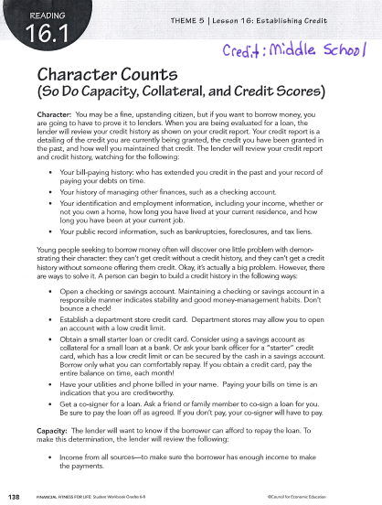
Establishing Credit

Slide 43
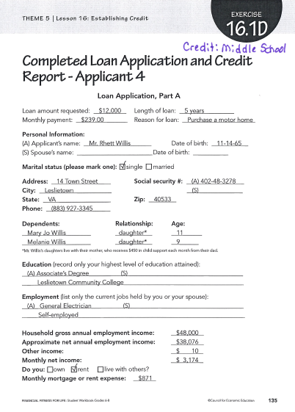
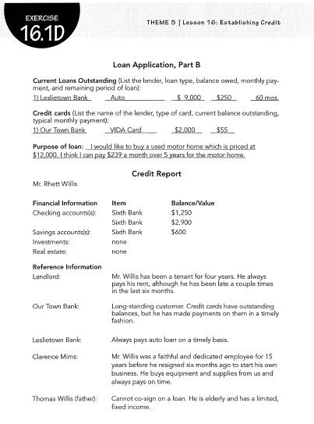

Slide 44
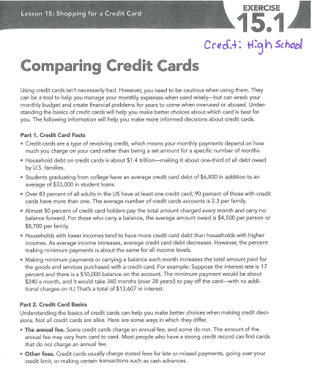
Which Credit Card is Best?

Slide 45
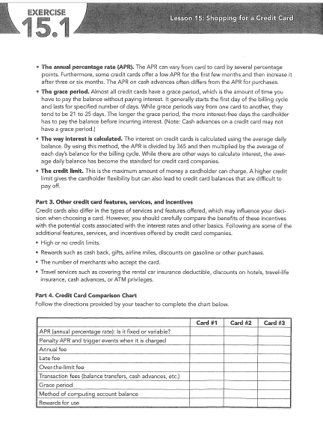
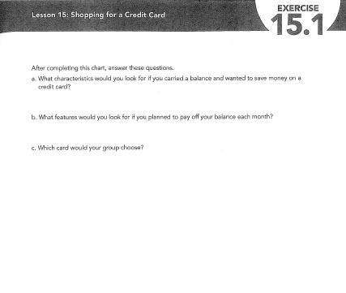

Slide 46
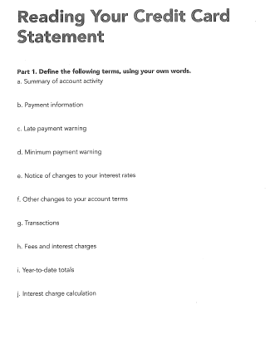
Credit Card Statements

Slide 47
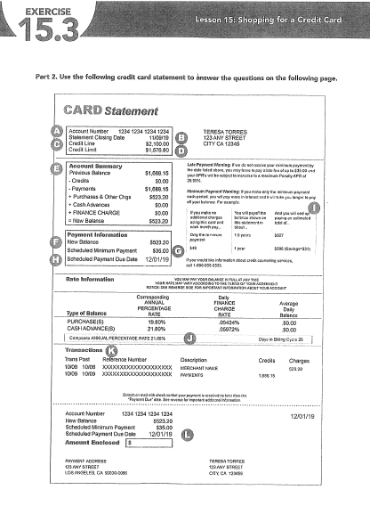
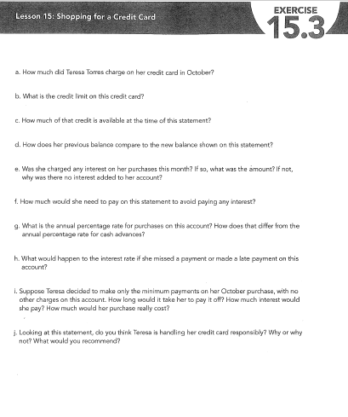

Slide 48
Questions?
THANK YOU!!

