Slide 1
Protecting Canadian Content: Paying for Our National Identity
Steven Globerman
Director of the center for
international business
Western Washington university
And
Senior fellow
The Fraser institute
February 2016

Slide 2
“Canada is the only country in the world that knows how to live without an identity” – Marshall McLuhan

Slide 3
- But a long-standing justification for government subsidization and protection of Canadian “culture” is that Canadian culture is a public service essential to maintaining and enhancing national identity and cultural sovereignty.

Slide 4
- A more recent justification is that popular culture industries make a large economic contribution to the Canadian economy, and that Canadian cultural industries need government support and protection to compete.
Jim Carrey’s Malibu Beach House

Slide 5
- How valid are these policy positions? Are They just special interest pleading?
Toronto Film Festival

Slide 6
Size of Canada’s Popular Culture Industries
Sector | Total Employment (2014)
Broadcasting (except Internet) | 37,611
Motion pictures and sound recording | 35,288
Publishing | 83,576
Total: Information and cultural industries | 316,470
All industries | 15,581,956
Information and cultural industries/all industries x 100 | 2.03%

Slide 7
Sources of Subsidies
Federal Government (Direct)
Canada Feature Film Fund (est 2014-2015) | $61 million
Canada Media Fund (2014-2015) | $134 million
Canada Book Fund (2012-2013) | $31 million
Canada Periodicals Fund (2012-2013) | $53 million
Canada Music Fund (2012-2013) | $9 million
CBC (2014-2015) | $1.07 billion

Slide 8
Sources of Subsidies
Federal and Provincial Governments (Indirect)
Canadian Film or Video Production Tax Credit (est) | $1.2 billion
Production Services Tax Credit (2011) | $0.4 billion

Slide 9
Regulations and Legal Restrictions
CRTC Content Rules for Broadcasters
CRTC “Preponderance” Rule
CRTC Simultaneous Substitution Rule
Illegal Satellite Ownership Rules
Foreign Ownership Restrictions

Slide 10
Content Rules
Private conventional TV licenses must devote not less than 50% of evening broadcast period (6PM – midnight) to Canadian programs
Radio broadcasters must have at least 35% of popular musical selections be Canadian selections

Slide 11
Preponderance Rules
CRTC will not authorize non-Canadian English and French language services if they compete with Canadian pay and specialty services
BDU’s will be required to offer more Canadian than non-Canadian services

Slide 12
Simultaneous Substitution
BDUs must replace the signal of an American channel with a Canadian signal when the same program is aired at the same time by an American broadcaster whose signal is distributed in Canada
Generates more advertising dollars for Canadian programs

Slide 13
The Internet
Broadcasting over the Internet remains unregulated
But for how long?
Canadian program services and BDUs must make financial contributions to Canadian programming. Netflix, Apple, YouTube, etc. do not

Slide 14
Social Costs of Culture Policies
Deadweight Costs of Government Policies
Public sector administration
Private sector administration
Lobbying activities
Higher taxes and subsidies discourage work/savings
Reduced access to foreign programming
Limited competition promotes inefficiency
Conflict with trading partners

Slide 15
Possible Social Benefits
Stronger Canadian identity makes better citizens
Less intra-national conflict
Increased pride

Slide 16
Possible Social Benefits
Stronger economy
External economies of scale (clusters)
Capturing economic rents from foreign consumers
The “creative class” promotes “creative cities”

Slide 17
How is Canadian Identity “Produced”?
No operational definition of Canadian identity
The Canadian government’s implicit model:
Canadian
Content
Canadian
Identity
Black Box

Slide 18
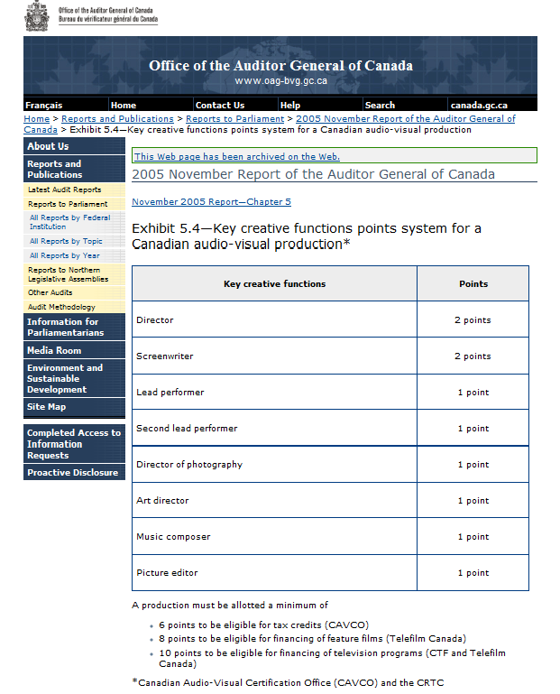
What is Canadian Content?
For purposes of government policy,
Canadian content is generally defined
with reference to citizenship of factors
of production (CAVCO point system).

Slide 19
So do you feel more “Canadian” because there are successful Canadian-born Entertainers/Authors?
Mixed evidence on whether watching American TV programs changes
Canadian values or attitudes toward Canadian institutions.

Slide 20
What/Who are “Symbols of Canada?”
From Dominion Institute National Survey of Canadians (Canada Day 2008)
What/who most defines Canada?
Answers:
1) Maple leaf 11) Rocky Mountains
2) Hockey 12) Wayne Gretzky
8) Pierre Elliott Trudeau 27) Celine Dion
9) Universal Health Care 89) Anne Murray

Slide 21
Evaluation of Economic Benefits
Acheson and Maule: Subsidies and government protection are not needed to encourage private sector production of popular culture.
Globerman and Stanbury: Talented Canadians often leave Canada, so rent transfers from foreigners don’t materialize and “learning spillovers” are attenuated [LA is 4th largest Canadian city].

Slide 22
Are Canadian Producers at a Competitive Disadvantage?
The cultural nationalists’ arguments:
Large economies of scale mean producers in small economies cannot compete with rivals based in large domestic markets.
Information costs and domestic purchasing preferences make it different for Canadian producers and artist to “export” their products and services.

Slide 23
Technological Change Further Qualifies Economic Arguments for Culture Policy
Technological change in information and computer technology (ICT) has drastically reduced the costs of producing and disseminating entertainment products.
Bill Gates: Putting an hour of video online cost $400 in the late 1990s. Today it costs around 2 cents.
- It is relatively easy to be “discovered” on the Internet.

Slide 24
So Why Does Culture Policy Persist?
It is a phenomenon of rent-seeking
Media interests are in a strong position to help or hurt politicians/political parties
The costs of the relevant policies are very obscure to tax payers.
The cultural identity argument is “mushy” and difficult to address on academic grounds.
Easy to paint opponents as being unpatriotic.
Freedom of choice is a public good.

